Slide 1
STM32CubeIDE Setup + Check
Embedded System

Slide 2
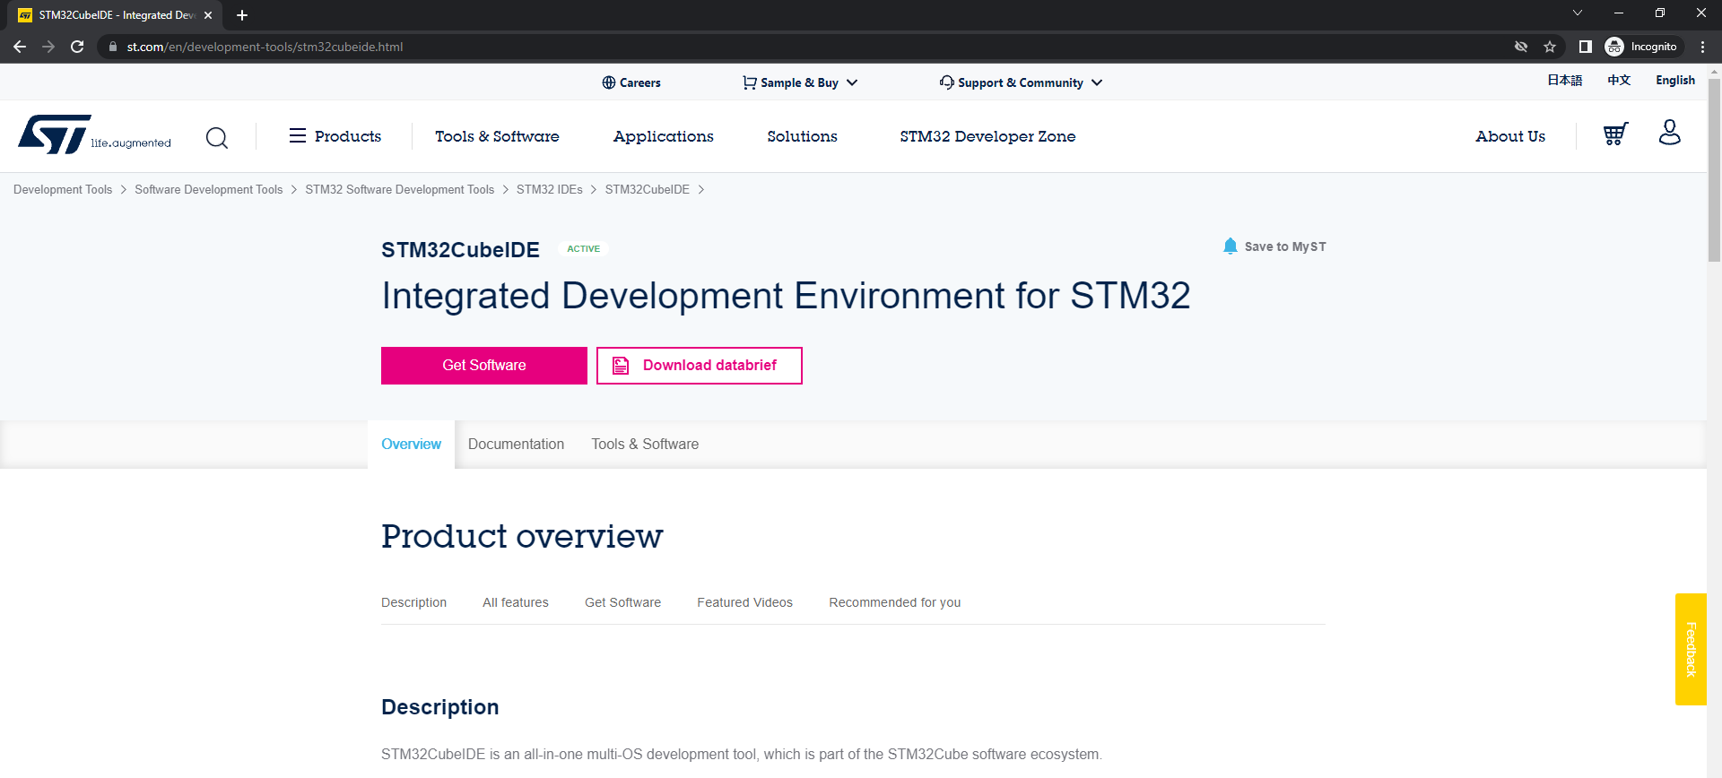
Download stm32 CubeIDE
Enter download link: https://www.st.com/en/development-tools/stm32cubeide.html

Slide 3
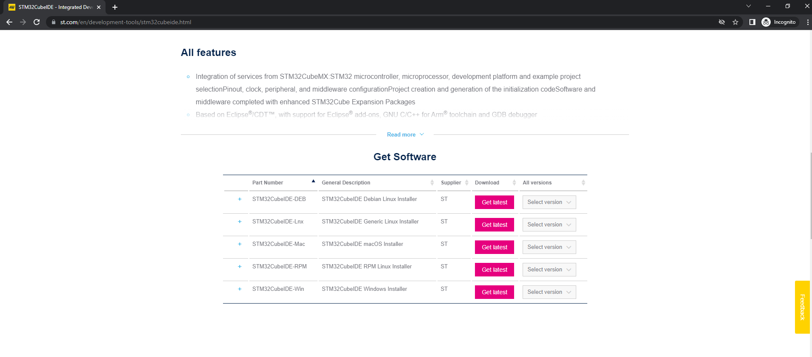
Download stm32 CubeIDE
Go down page till ‘Get Software’ part and download according to your OS

Slide 4
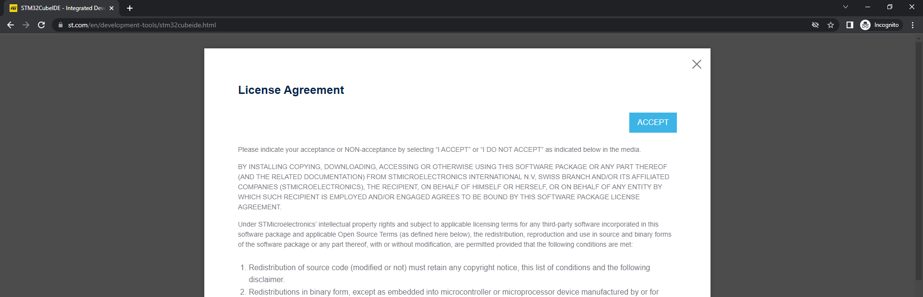
Download stm32 CubeIDE
Accept License Agreement

Slide 5
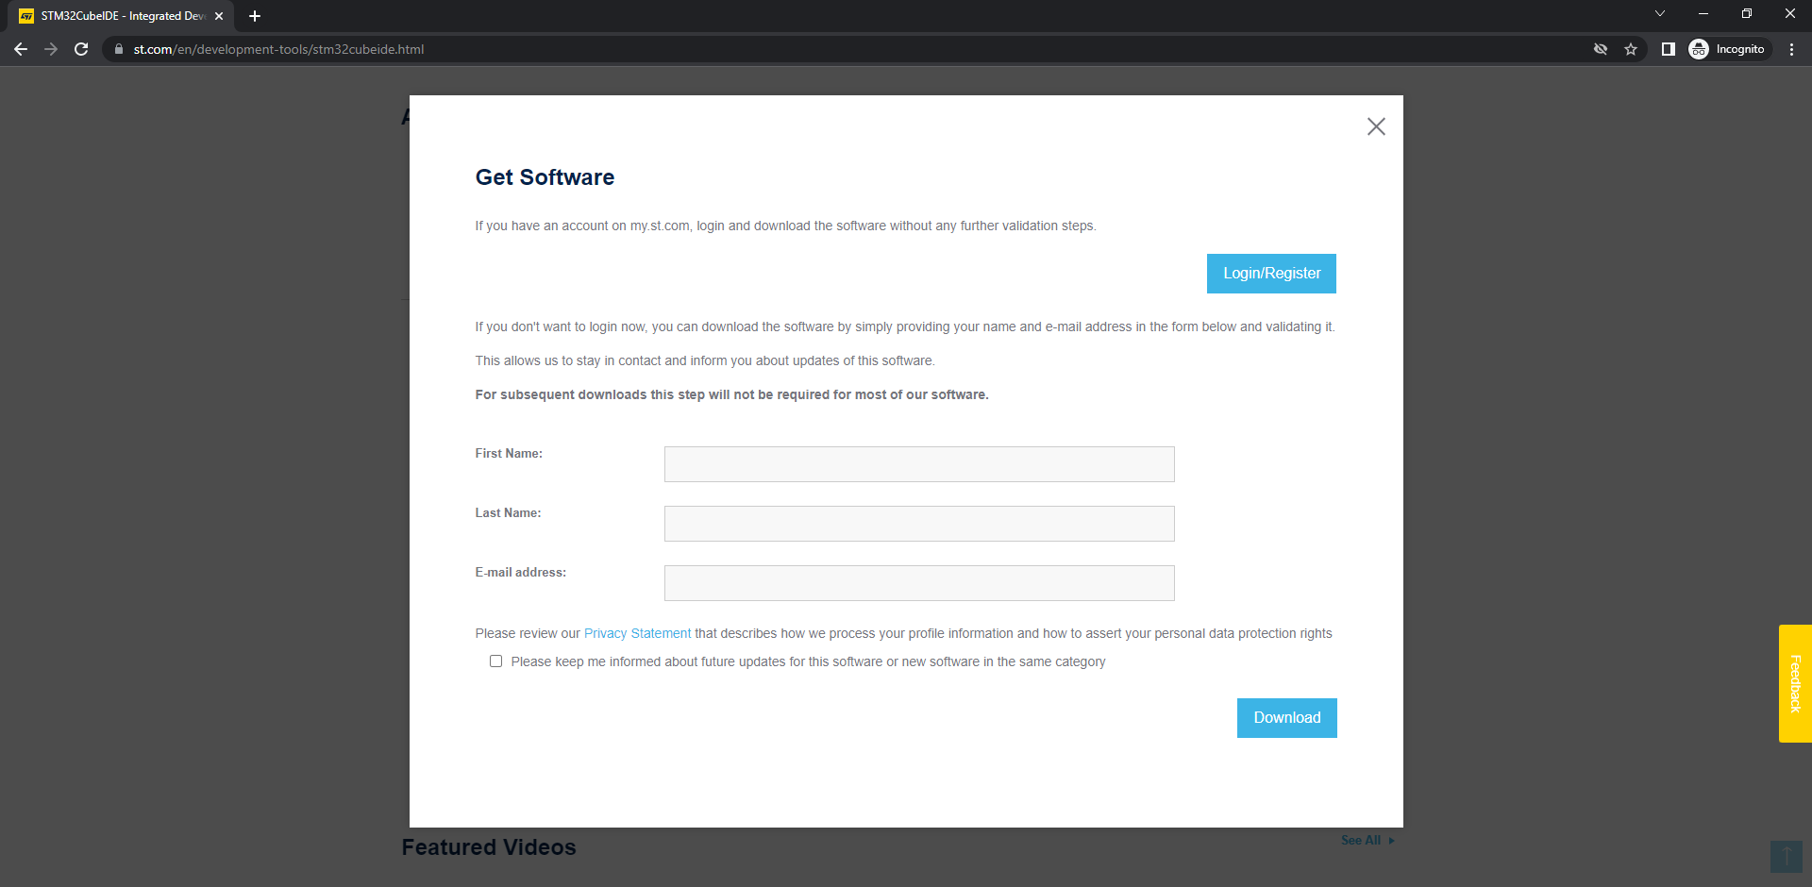
Download stm32 CubeIDE
Enter name and email. Don’t check box and press download

Slide 6
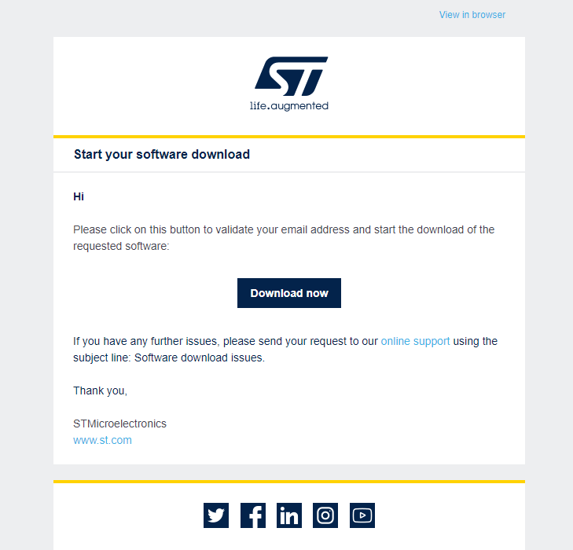
Download stm32 CubeIDE
Check email from STMicroelectronics
Press ‘Download now’ button
New tab will open, wait a bit(might take some time)
New tab will open ‘st.com’ page and start downloading automatically
If download doesn’t start or you have any problems, try checking cookies

Slide 7
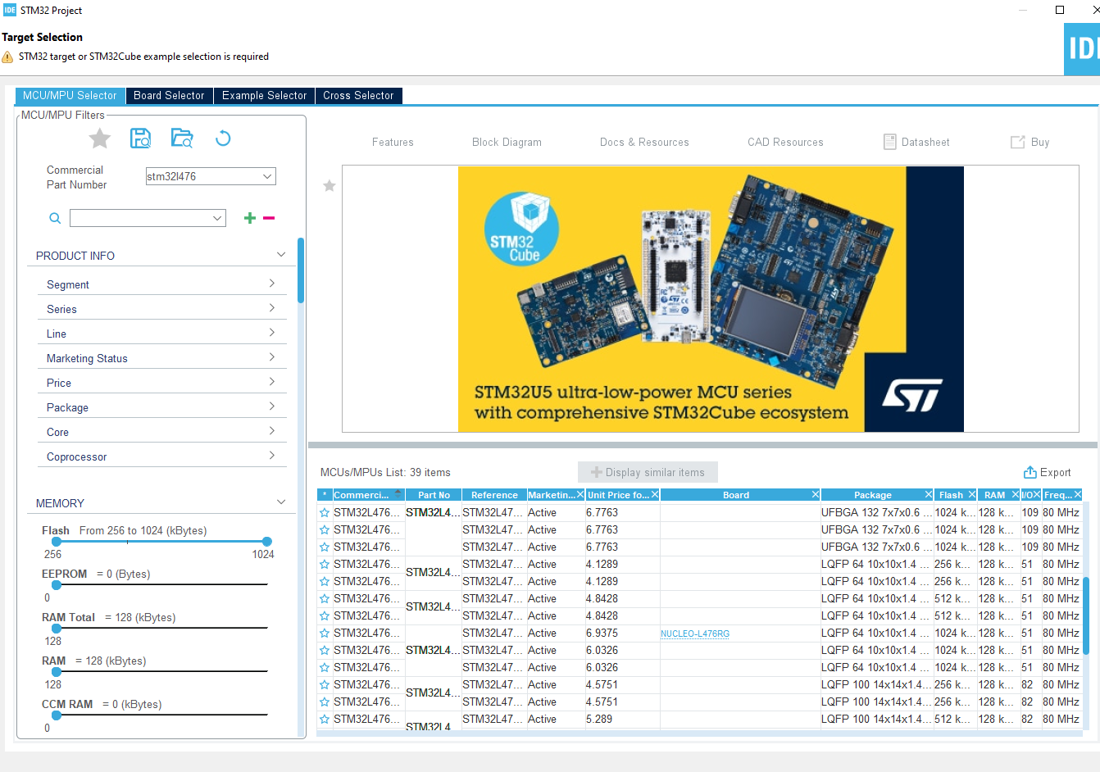
Setup stm32 CubeIDE
Go to ‘File’->’New’->’STM32 Project’
Type ‘stm32l476’(It’s the letter ‘l’ not 1) in the ‘Commercial Part Number’ area
Check the list at the bottom right. Click the line with ‘Board’ as ‘NUCLEO~’ then press ‘next’

Slide 8
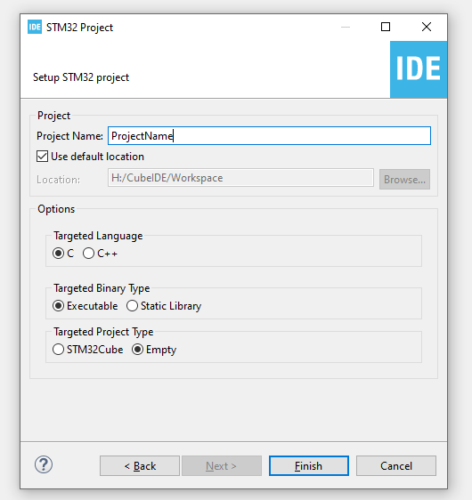
Setup stm32 CubeIDE
Enter project name and change ‘Targeted Project Type’ to ‘Empty’.
Press ‘Finish’

Slide 9
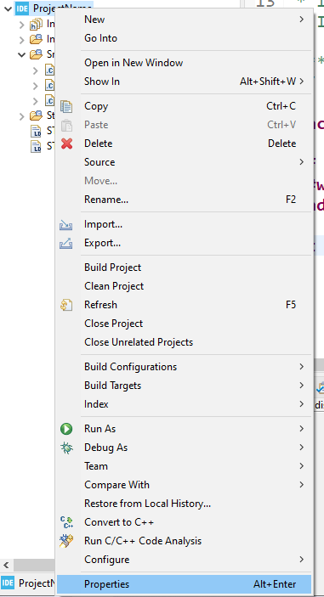
Setup stm32 CubeIDE
Right click project folder->press ‘Properties’

Slide 10
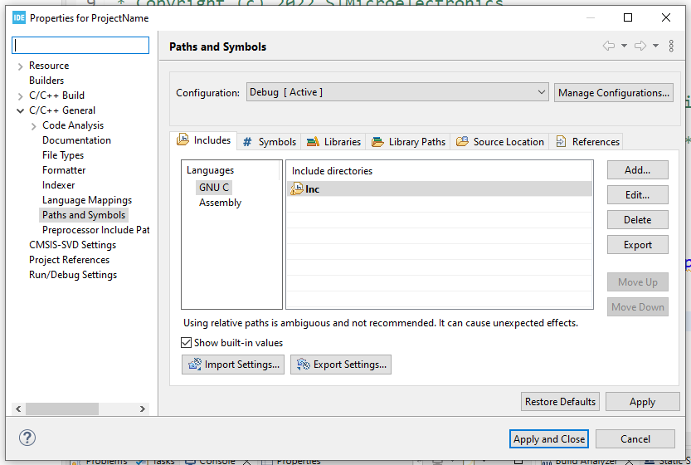
Setup stm32 CubeIDE
Open ‘C/C++ General’->’Paths and Symbols’
Press ‘Add’->In ‘Directory’ box paste both ‘Include’ folders from downloaded ‘chip_headers’ file.(Extra explanation at next slide)
Press ‘OK’->’Apply’->’Apply and Close’

Slide 11
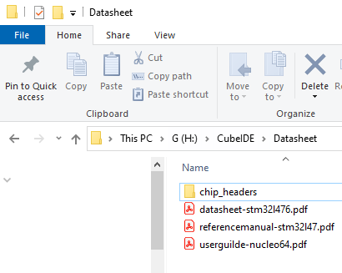
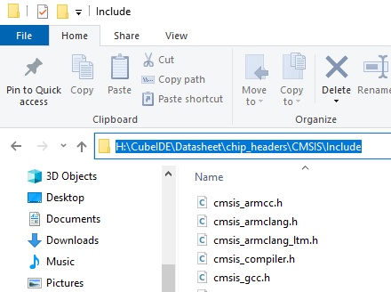
How to get folder path
Open the folder that contains ‘chip_headers’ file
Go to ‘chip_headers’->’CMSIS’->’Include’
Click on address bar. Copy text. Paste to ‘Directory’ from previous slide. Press ‘OK’
Go to ‘chip_headers’ ’->’CMSIS’->’Device’ ->’ST’->’STM32L4xx’->’Include’
Click on address bar. Copy text. Paste to ‘Directory’ from previous slide. Press ‘OK’

Slide 12
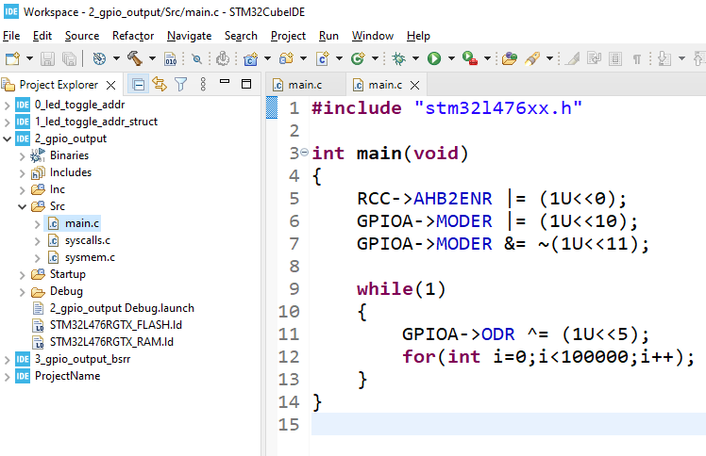
Setup stm32 CubeIDE
Open src->main.c File
Delete existing code and copy code
Connect board to PC(Check if board lights up)
Build code(Hammer button)
Upload code to board(Play button)
Board green LED should blink

Slide 13
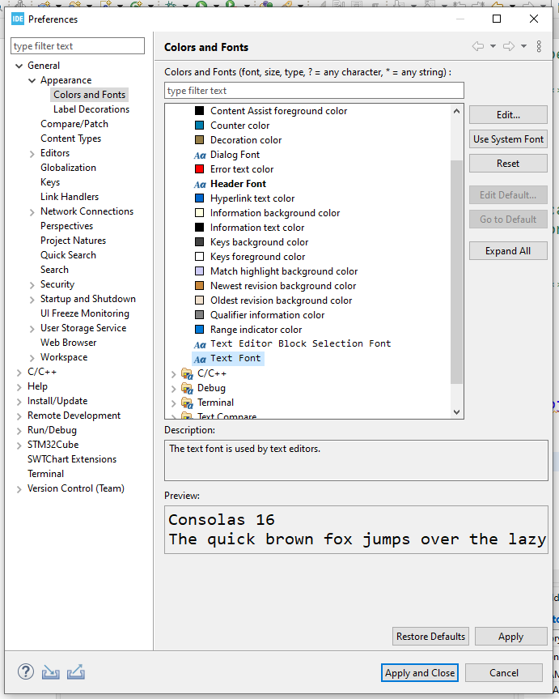
Setup stm32 CubeIDE: Font change
To change font / text size go to ‘Window’-> ’Preferences’
Drop down ‘General’->’Appearance’->Click ‘Colors and Fonts’
Basic->Click ‘Text Font’->Press ‘Edit’ button.
Edit font / font size

